Slide 1
19CSE211 COMPUTER ARCHITECTURE & ORGANIZATION
MIPS-PIPELINED ARCHITECTURE-Part3

Slide 2
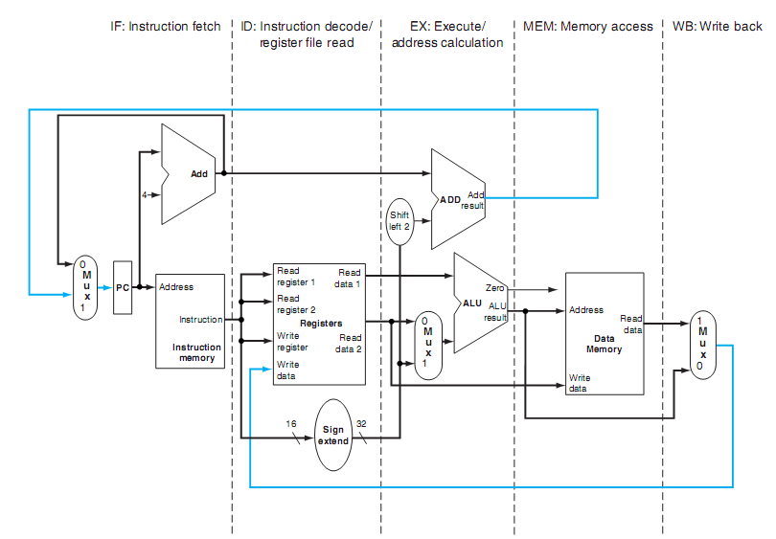
Pipelined datapath

Slide 3
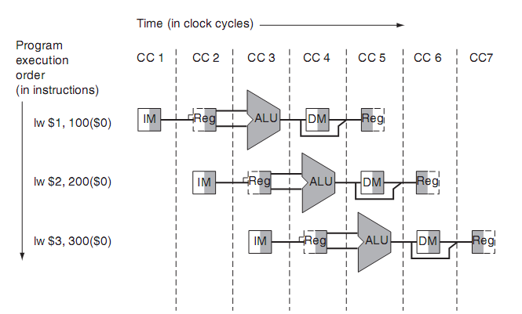
Pipelined datapath

Slide 4
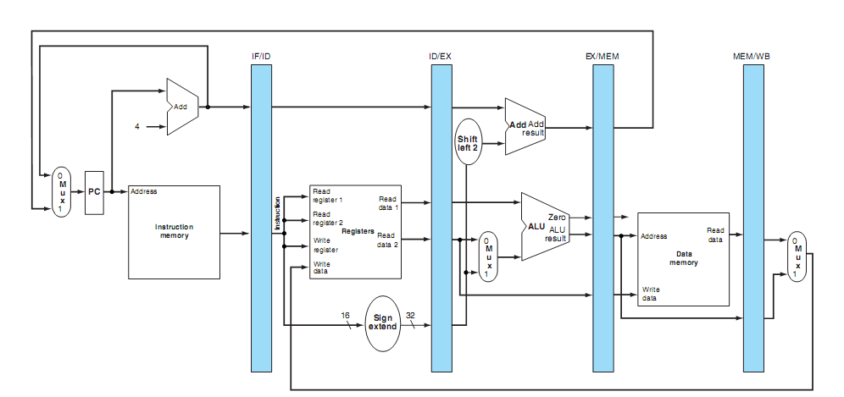
Pipelined datapath with pipeline registers

Slide 5
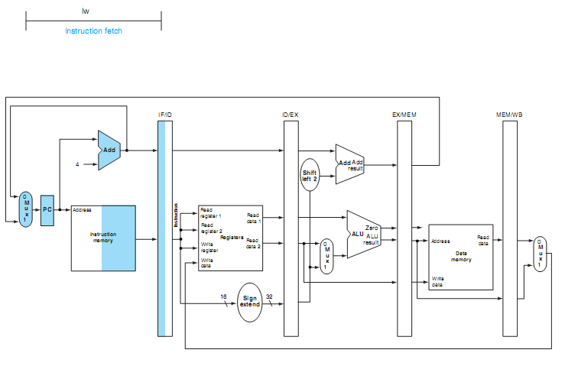
Stages of lw instruction

Slide 6
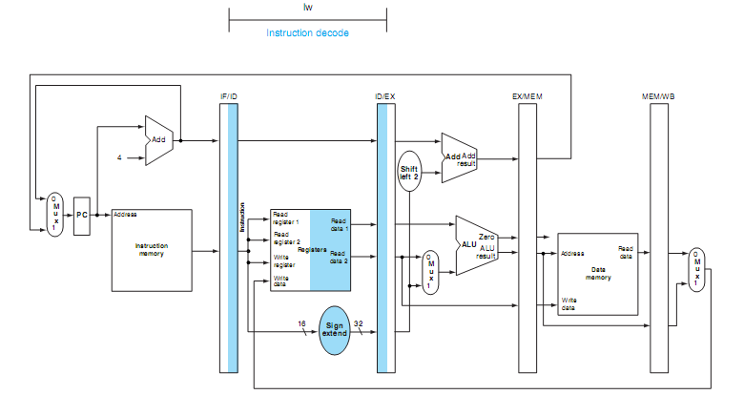
Stages of lw instruction

Slide 7
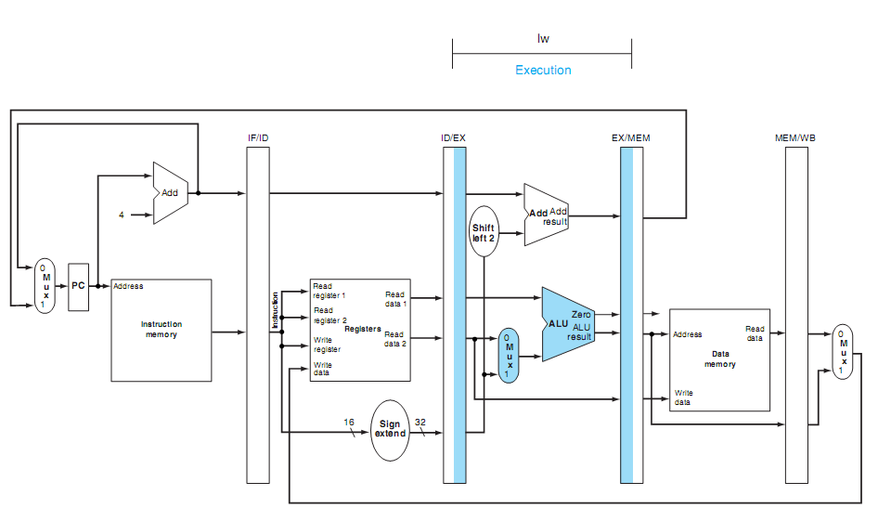
Stages of lw instruction

Slide 8
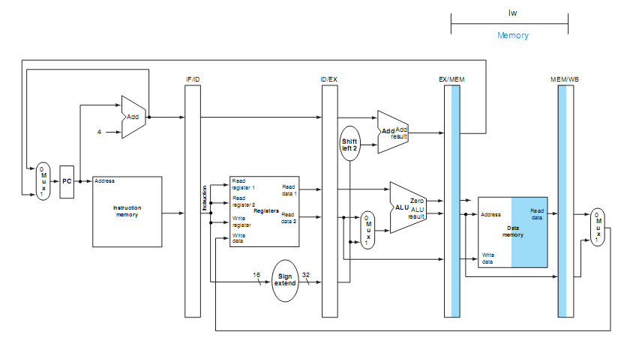
Stages of lw instruction

Slide 9
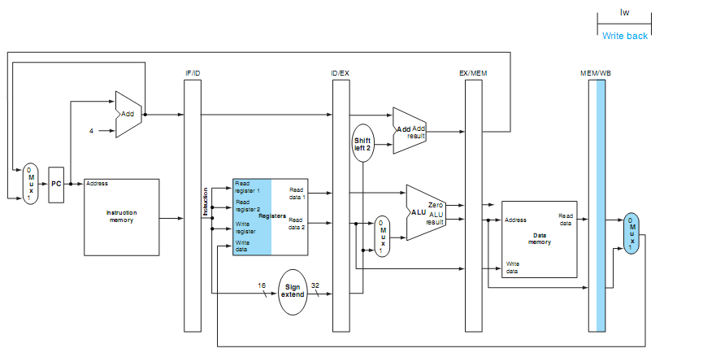
Stages of lw instruction

Slide 10

Stages of sw instruction

Slide 11
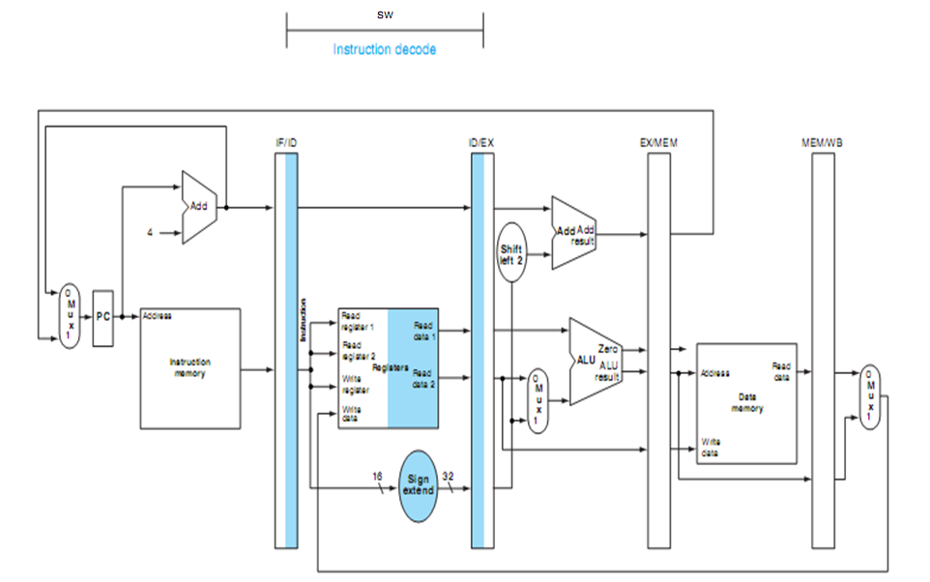
Stages of sw instruction

Slide 12
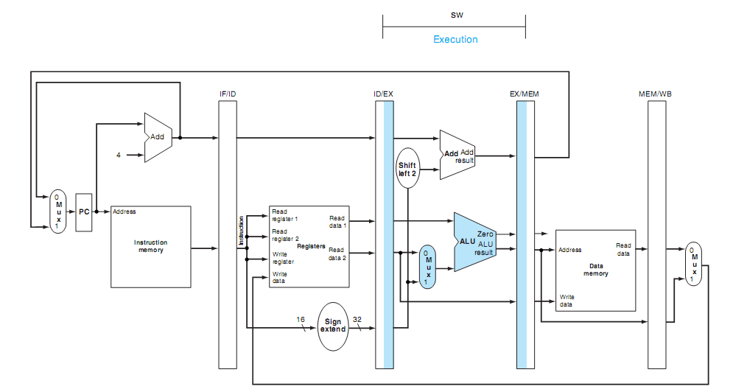

Stages of sw instruction

Slide 13
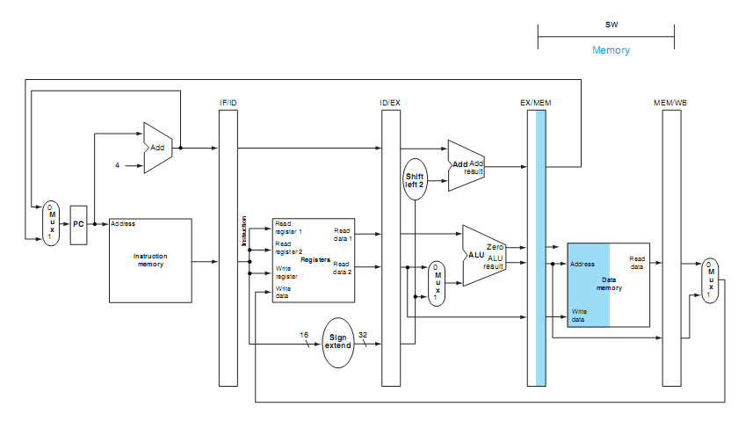
Stages of sw instruction

Slide 14
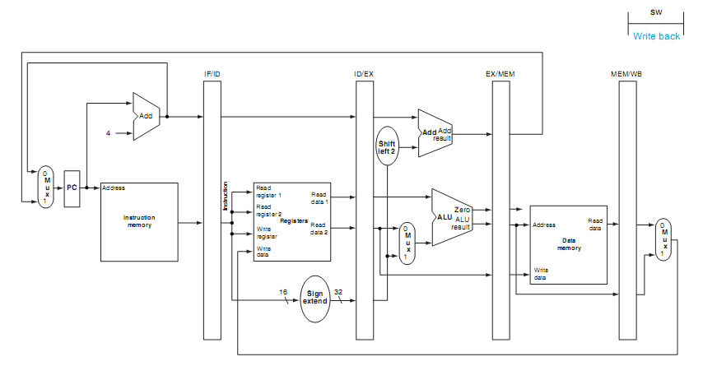
Stages of sw instruction

Slide 15
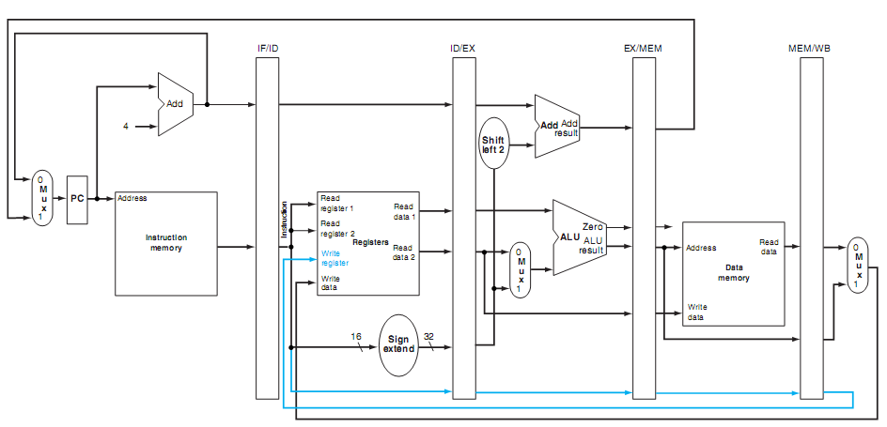
Corrected datapath for lw instruction

